Slide 1
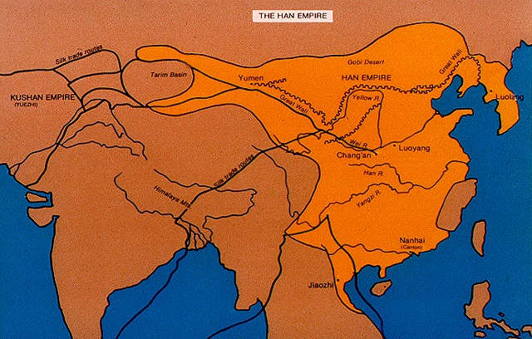
MEDIEVAL CHINA

Slide 2
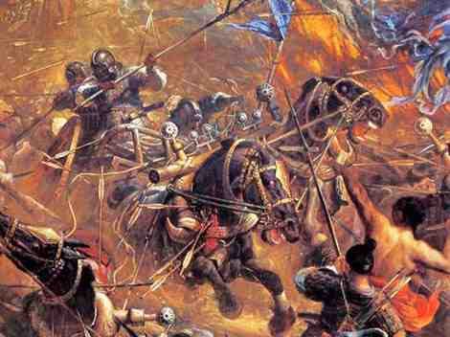
Period of Disunion
When Han Dynasty collapsed, China broke into several rival kingdoms, each ruled by military leaders.
The was a time of disorder that followed the collapse of Han

Slide 3
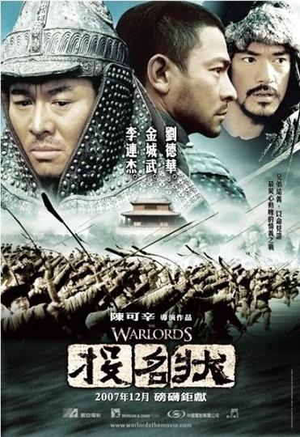
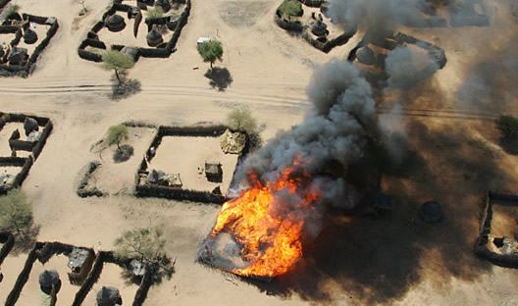
Intro: During Period of Disunion, cities and farms were destroyed.

Slide 4
Escape During Period of Disunion
– a religion that offers comfort from suffering
- stresses individual life and spirituality.
Buddhism
Daoism

Slide 5
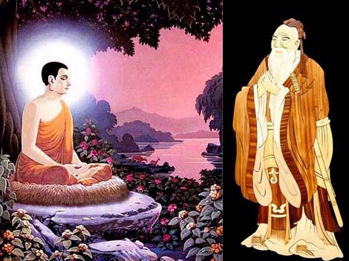
Confucianism vs. Buddhism
Buddhism – a religion that stresses a spiritual outlook and an escape from suffering.
Confucianism – a philosophy that stresses ethical and proper behavior.

Slide 6
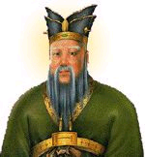
Confucianism
led to an orderly Chinese society because it encouraged believers to follow their roles in society and obey their emperor.

Slide 7
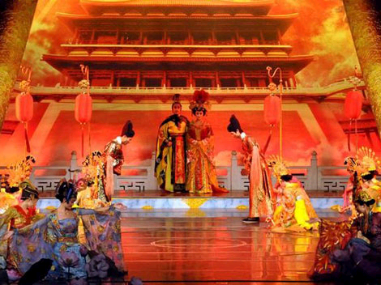
Tang
Historians view the dynasty as the Golden Age of Chinese civilization.

Slide 8
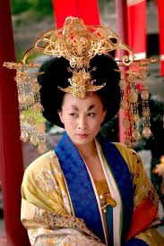
She was the only woman to take the title of emperor.
She ruled during the Tang Dynasty
She cut taxes
Raised the salaries of government officials,
Reduced expensive military operations,
Reformed the government.
She wanted to win the loyalty of the people.
Empress Wu

Slide 9
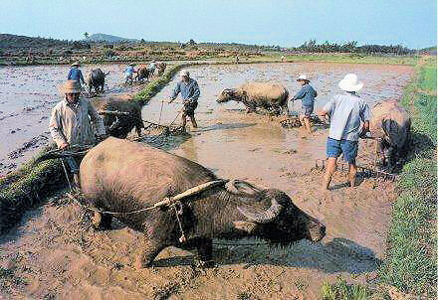
More land was cultivated for farming
Why did farming improve during Song Dynasty?
Farmers developed new kinds of rice which grew faster and easier

Slide 10
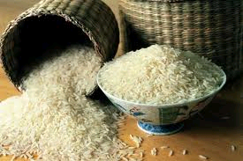
More food means more people!

Slide 11
What is the reason cities grew during the Tang and Song Dynasties?
Trade of rice (agricultural crops)

Slide 12
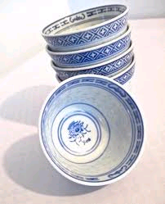
Chinese Exports
Tea, Rice, and Porcelain

Slide 13
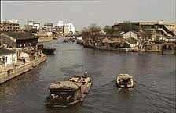
Why does trade grow during the Tang Dynasty?
, 1,100 mile long structure filled with barges carrying rice and other products, was built creating greater trade between North and South China.
Grand Canal

Slide 14
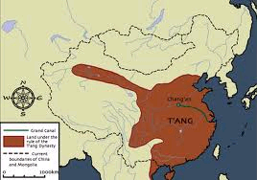
Cities and Trade
What was the capital of the Tang Dynasty?
Chang’an

Slide 15
Why did the Tang support Neo Confucianism?
They wanted to make Buddhism less important in the society.

Slide 16
What is Neo Confucianism?
Combination of Confucianism and Buddhism (ethical and spiritual).

Slide 17
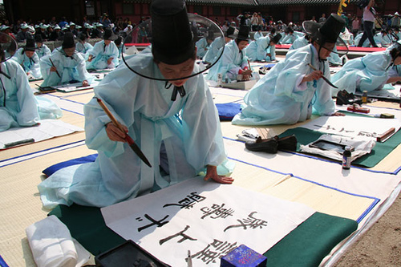
Students preparing for civil service examinations in China spent years memorizing writings
Confucius’

Slide 18
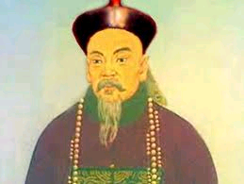
How did having a bureaucracy of scholar-officials affect the Song Dynasty’s government?
Made the government more efficient and stable.

Slide 19
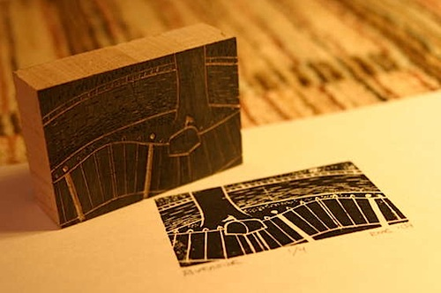
1. :
Allowed Chinese to copy and print texts or drawings very quickly and in large quantities.
Wood Block Printing

Slide 20
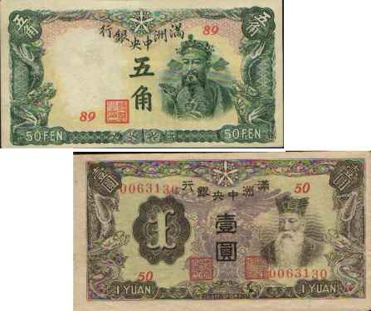
Printing Press
Paper was invented during the Han
Printing leads to paper currency

Slide 21
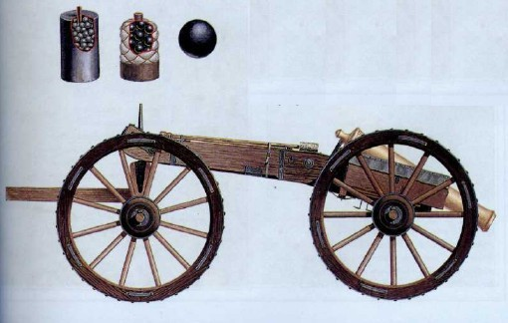
Other Inventions
– leads to firearms (guns)
Gunpowder

Slide 22
Other Inventions
– thin, beautiful pottery
Porcelain

Slide 23
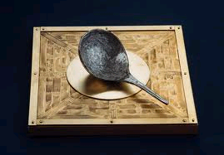
Other Inventions
– helps explorers go farther, discovery of Americas
Magnetic Compass

Slide 24
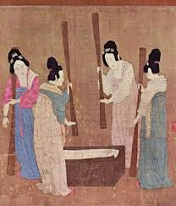
Other Inventions
The Chinese keep the and making process secret from other cultures so that they could monopolize the trade for higher profits.
Silk and Porcelain

Slide 25
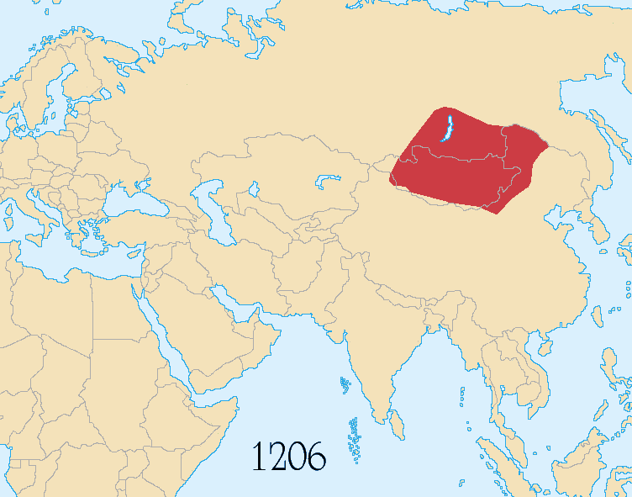
THE MONGOLS

Slide 26
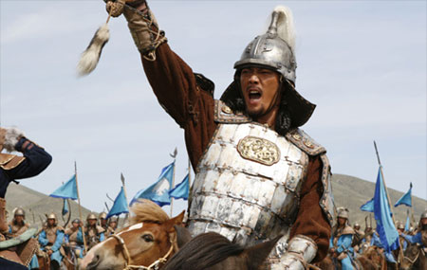
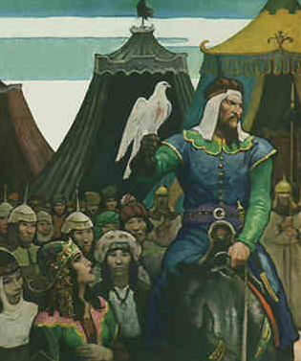
Mongol Empire:
organized the Mongols who lived north of China (Mongolia) into a powerful army
Known for 2 things: horseback riding and war
Bloody and brutal attacks on much of Asia and Eastern Europe, killing men, women, and children in countless cities and villages
Grew wealthy from taxing goods they traded
Genghis Khan

Slide 27
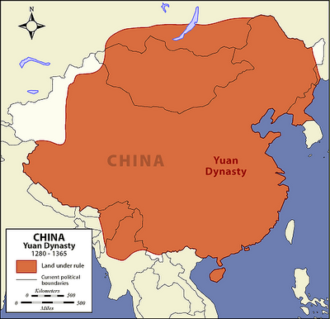
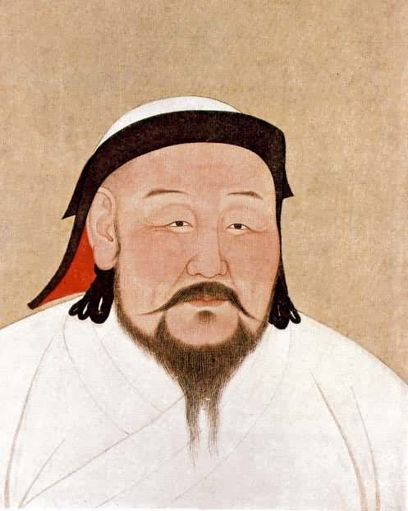
Mongol Empire:
, Genghis Khan’s grandson conquers China and declares himself emperor and begins the Yuan dynasty
The Yuan Dynasty marked the height of China’s power
Kublai Khan

Slide 28
Yuan Dynasty:
The Mongols belonged to a different ethnic group, spoke a different language, worshipped different gods, wore different clothing, and had different customs
Kublai Khan kept control of the Chinese
did not force the Chinese to accept the Mongol way of life
Sending Mongol soldiers throughout China to keep peace and watch for trouble.
Making sure half of the civil service positions were of non-Chinese people.
Making the Chinese people pay very high taxes.

Slide 29
Yuan Dynasty:
Mongol emperors welcomed foreign traders such as , to Chinese ports.
Europeans learned that China was a highly civilized country.
Marco Polo

Slide 30
End of the Yuan Dynasty:
Failed Mongol invasion of Japan
Mongol empire could not hold back Chinese rebellion

Slide 31
MING DYNASTY
Took over after Yuan Dynasty
Brought back official system of government
Built Forbidden City
Restored Great Wall
Practiced – policy of avoiding contact with other nations
Isolationism

Slide 32
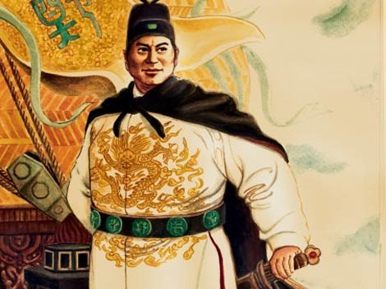
ZHENG HE

Slide 33
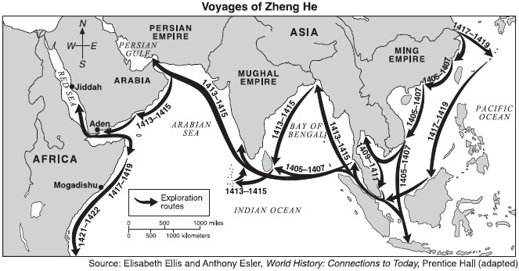
Led 7 great voyages around India and to the east coast of Africa
Showed off the power of China

Slide 34
Isolationism
Effect of China:
Western world had made huge leaps in technological progress

